Slide 1

Lesson 2.4: Variables
Microsoft Philanthropies TEALS Program
Introduction to Computer Science

Slide 2
After this lesson you will be able to
Use variables to track values throughout a program

Slide 3
Today’s Plan
Do Now
Lecture
Lab
Debrief

Slide 4


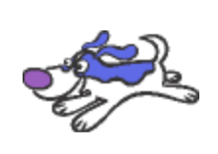
Do Now 2.4
Access the project at AKA.MS/DoNow2.4
This is a two-player game of tag where the players use the keyboard to control Alonzo and the Blue Dog.
There are at least SIX bugs in this program – four affect gameplay and two are cosmetic – can you find them all?
BONUS – If you’ve fixed all the bugs, can you think of some changes you could make to the program to make the game more fun?
Notes:
Students can find a two-player tag game at aka.ms/DoNow2.4. The objective of the game is that one player can chase the other in a game of tag using the computer keyboard.
The game at the link will not work as described. The students should attempt to find the four bugs that prevent the game from working (three in the Alonzo sprite code and one in the Blue Dog sprite code). There are also two bugs in the Blue Dog code that don’t affect gameplay.
If students fix the bugs quickly, they can think about ways to make the game more fun with some small modifications.

Slide 5
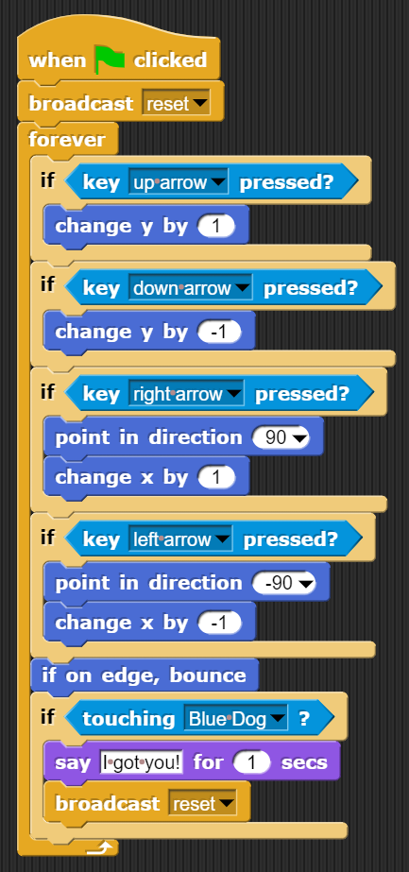
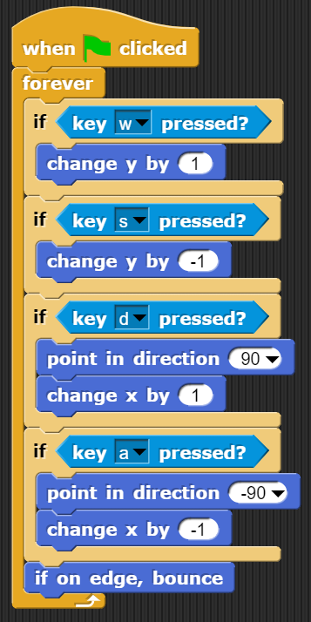
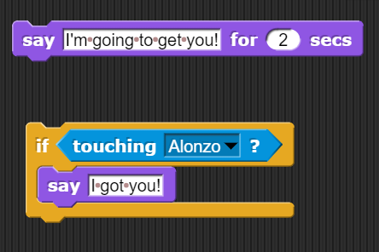
Do Now 2.4 Solution
Conditionals should be in a forever loop
Conditionals should be in a forever loop
4
1
5
Delete unused block
Left arrow conditional not inside right arrow
2
If on edge, bounce block outside of left arrow
3
6
Delete/change message
Notes:
The six bugs:
The conditionals to check for the arrow key presses need to be in a forever block or the code execution will end before more than one key press has been detected.
The conditional to check for the left arrow key press is inside of the conditional for the right key press, so Alonzo will never move to the left.
The if on edge, bounce block is inside the conditional for the left arrow, so Alonzo will run off the screen in every direction except the left.
The conditionals testing for the W-A-S-D key presses for the Blue Dog need to be in a forever block or only one key press at most will be detected before the code exits
There’s an unused say block in the Blue Dog scripting area. Deleting unused code is good coding practice.
The Blue Dog says I got you! when Alonzo touches it. Since the Blue Dog is the one being chased, that doesn’t make much sense. The message should be changed or deleted. (Alonzo already says I got you! when touching the Blue Dog.)

Slide 6
Do Now 2.4 Bonus
Did you think of some ways to make the game more fun?
Notes:
Ask the students if they had any ideas for improving the game. Some possible suggestions they might have:
Have a score counter that increments when the reset message is sent. (After Alonzo catches the Blue Dog.)
Since Alonzo starts on the left of the screen and the Blue Dog starts on the right, have Alonzo be controlled by the W-A-S-D keys and the Blue Dog by the arrow keys. That way, the control keys are on the same side of the keyboard as the sprites they are controlling.
Have the computer control the Blue Dog using random movements.
Have the computer control the Blue Dog by always moving in the opposite direction from Alonzo.
Have the players choose which character is being chased at the beginning of the game.

Slide 7

2.4 Lecture: Answer Block
How do you think the ‘answer’ block works?
Why is that important for a computer program?
Notes:
https://tealsk12.gitbook.io/intro-cs/unit_2/lesson_24#1-lecture
Remind students how the code from the last lecture that used the ask and answer block. ​
Review user input, specifically the block
Ask students to speculate about how the block works
Students should recognize that the block must be storing a value somehow and remembering it for later
Ask students whether that type of functionality might be useful in other cases

Slide 8
2.4 Lecture: Variables
Variable: a location in memory to store a value for retrieval and use later
Notes:
https://tealsk12.gitbook.io/intro-cs/unit_2/lesson_24#1-lecture
Consider introducing variables with an interactive physical demonstration by modifying the The Box Variable Activity for your students.
Demonstrate creating, assigning, and accessing a variable in SNAP
Ignore global vs. this sprite only for now
Point out that a variable can only hold one value at a time
When a new value is assigned, the old value is lost and cannot be recovered
Emphasize the importance of descriptive, readable names for variables
Show that variables are independent
One variable's value can be assigned to another, as in , but changing the value of var2 later will not update the value of var1

Slide 9



Lab 2.4: I’m thinking of a number
In this lab, you will use conditional statements and variables to build a simple number guessing game. You will write a SNAP program to choose a random number between 1 and 10 and then ask the user to guess a number. If the user's guess matches the random number, the user wins. If not, the user loses.
Fill out the planning worksheet
Build the game
(Bonus) Upgrade the game
Notes:
Briefly demonstrate the (green) pick random block, which will be used in the lab.
https://tealsk12.gitbook.io/intro-cs/unit_2/lesson_24/lab_24

Slide 10

2.4: Debrief
Notes:
Discuss and demonstrate one or more students' submissions
Ask students for commentary on usage and naming of variables throughout program

Slide 11

Exit Ticket
In your notebook, tell me about one strategy you use when you are frustrated with your code.

